Slide 1

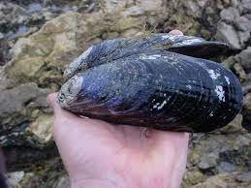


Preliminary analysis of population structure in Mytilus californianus
Vanessa Garcia¹, Nate Jue¹, Eric D. Crandall^{1,2}
Department of Biology and Chemistry, California State University Monterey Bay, 100 Campus Center, Seaside, CA
Department of Biology, Pennsylvania State University
208 Mueller Laboratory, University Park, PA

Slide 2
Research Questions
Is there evidence of population structure in the California mussel?

Slide 3
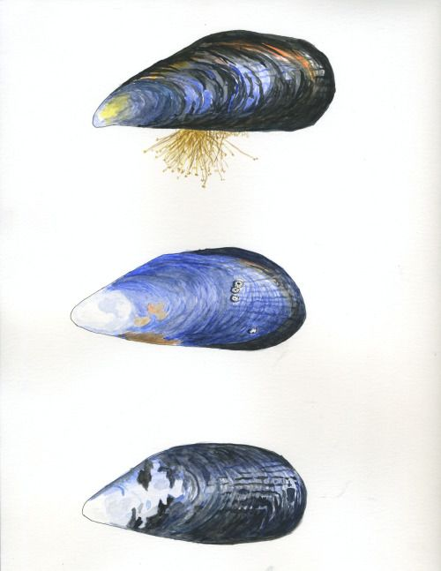
Mytilus californianus
Inhabit the coastal waters of western North America (Strathman 1985)
Spawn year-round (Suchanek 1981)
Larvae drift for up to 45 days (Suchanek 1981)
Life-span up to 50 years (Gosling 1992)
Research question: Is there evidence of population structure?
Hoskins, Rebecca. California Mussels (Mytilus californianus). Watercolor and Ink. [BeckinszIllustration.tumblr.com]. Accessed May 17, 2021.

Slide 4
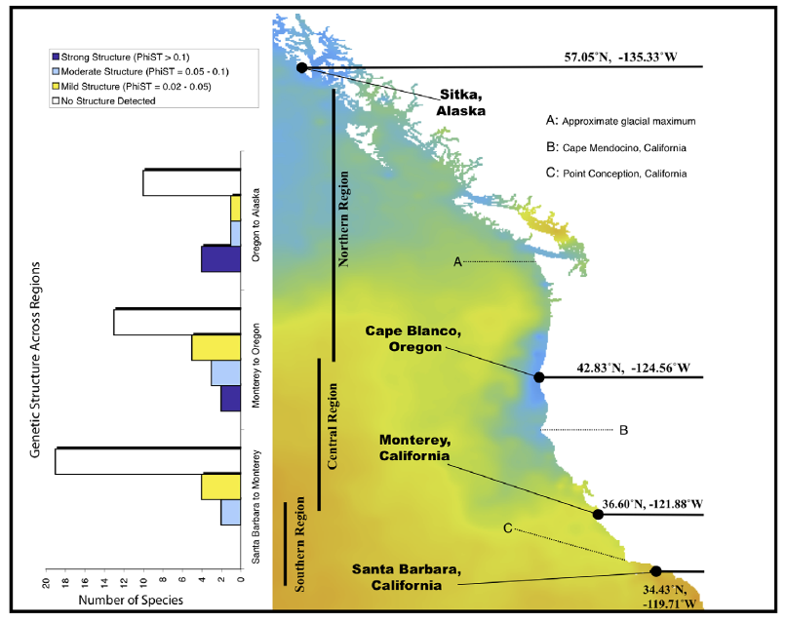
Previous Research
Addison et al. 2008 concluded genetic homogeneity throughout range using various genetic markers (ΦST =
–0.0029)
Marko et al. 2010 found similar lack of population structure (ΦST = 0.004)
Kelly and Palumbi 2010 found only 13 of 50 intertidal species show significant population structure using F-statistics!
Kelly and Palumbi 2010 PLoS One

Slide 5

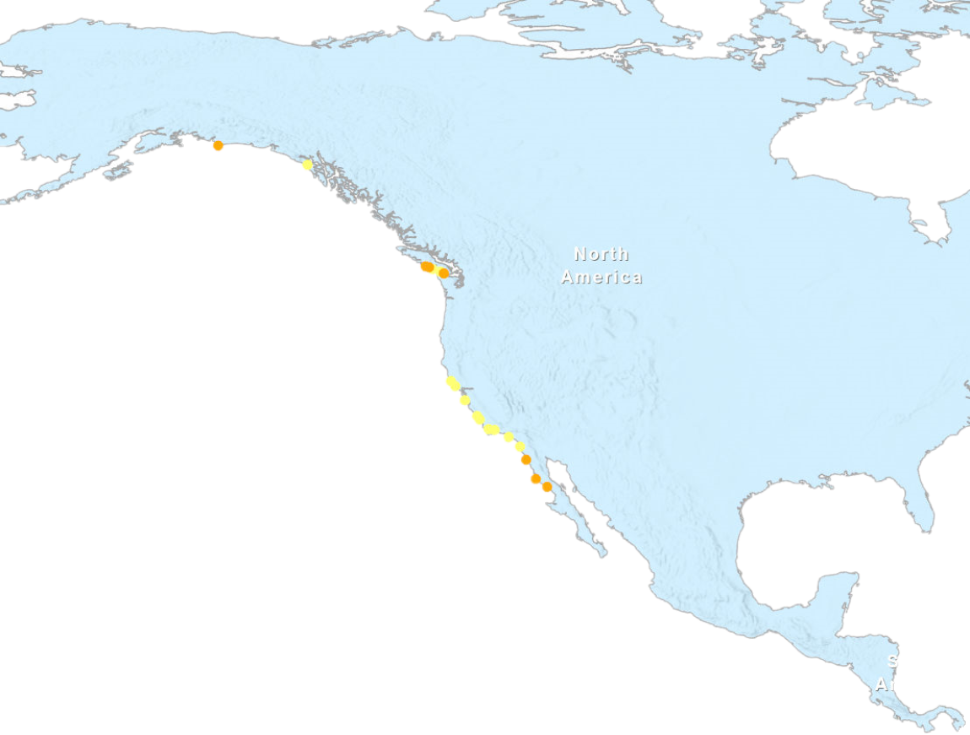
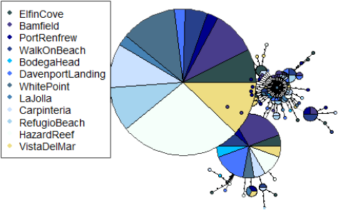
Data Collection & Processing
Isolated mitochondrial DNA from 138 mussels in 10% Chelex solution
Amplified cytochrome c oxidase (COI) gene with polymerase chain reactions (PCR)
Sequenced at MCLAB
Edited chromatograms and aligned sequences in Geneious software
Marko et al. 2009 n = 57
National Center for Biotechnology Information Database
Pt. Conception
Extract DNA
Sequence DNA
Diversity Statistics
Hypothesis Tests (AMOVA)
Coalescent Model Selection
Figure 1: A haplotype network which visualizes the number of base substitutions required to get from one haplotype to the next.
Sample Sites | Map Symbol
Current
Future
Notes:
Change dots to yellow and add future sites for baja, Alaska, cali, Oregon (in diff color?) and also Criego-Prieto data

Slide 6
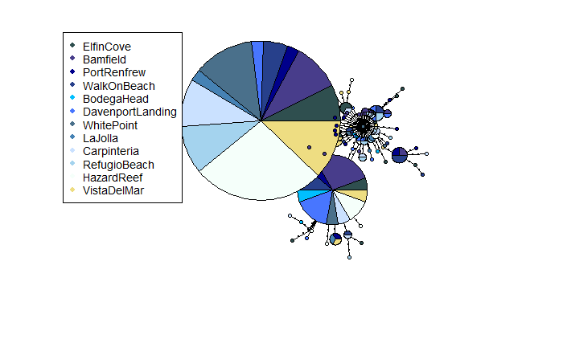
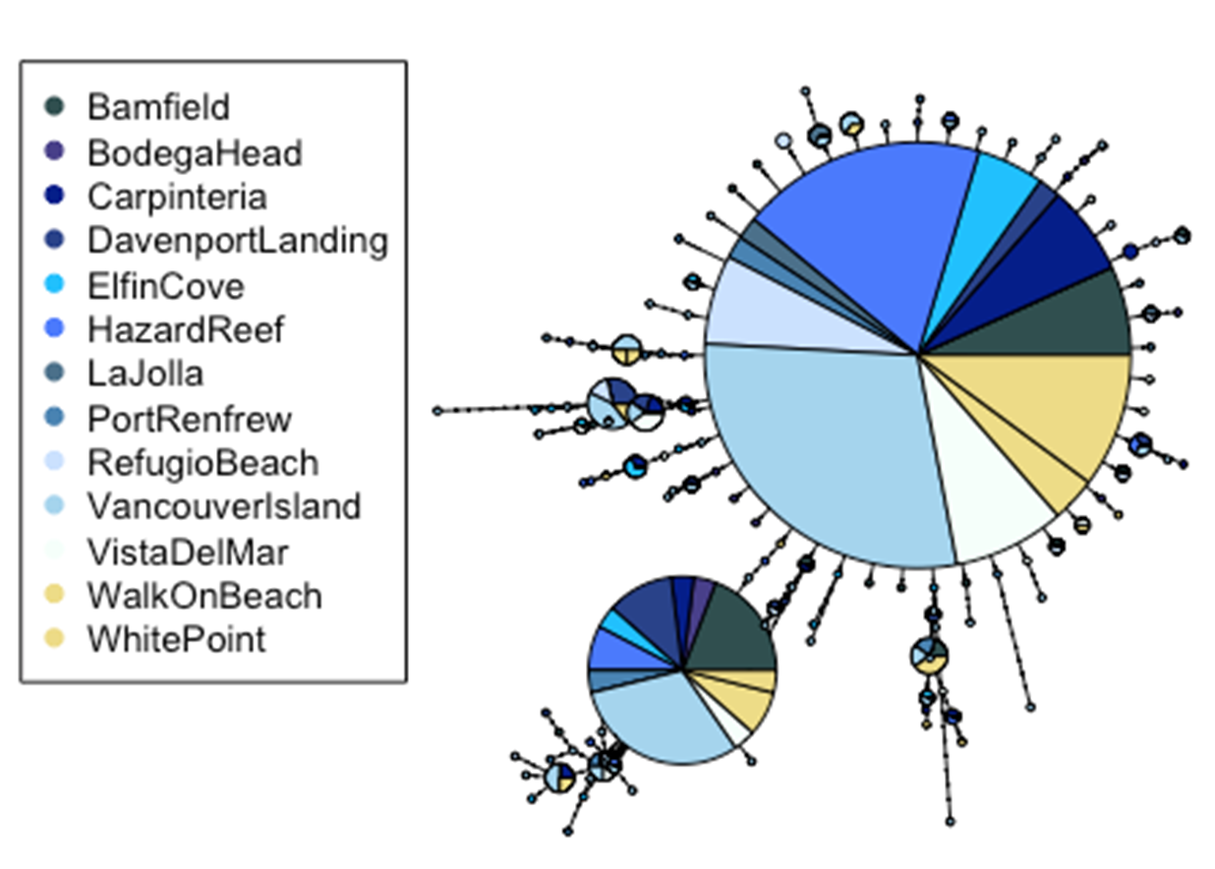
Figure 1: A haplotype network which visualizes the number of base substitutions required to get from one haplotype to the next.

Slide 7
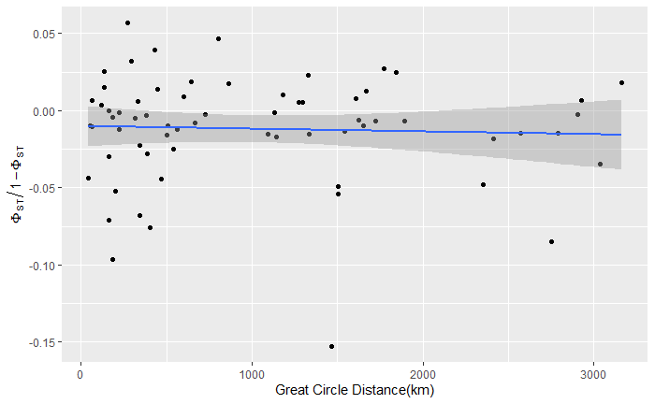
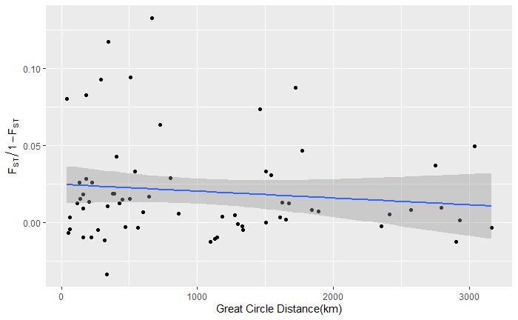
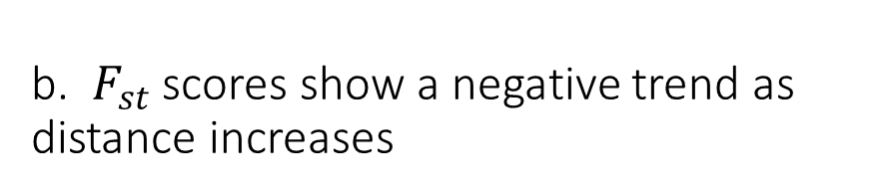
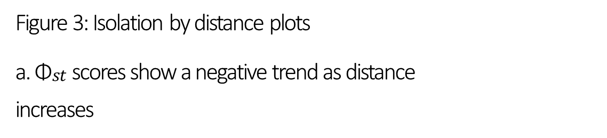
Figure 3: Isolation by distance plots a. ${\text{Φ}}_{\begin{aligned}st \\ \end{aligned}}$ scores show a negative trend as distance increases
b. $F_{st}$ scores show a negative trend as distance increases

Slide 8
Table 1: Analysis of Molecular Variance (AMOVA) results
 | Pt. Conception Hypothesis | Cape Mendocino Hypothesis | Addison et al. 2008 | Marko et al. 2010 | Our Results
Among Regions | -.0019 | -.0085
Among Populations within Regions | -.0204 | -.0162
Among Populations | -.0224 | -.0249 | -.0029 | .004 | -.0213

Slide 9
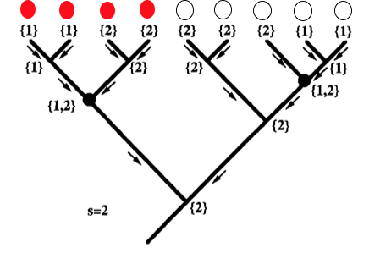
Solutions from coalescent samplers
Population 1
Population 2
Slatkin and Maddison 1989
Beerli and Felsenstein 1999, 2001

Slide 10
Previous Research with Coalescent Samplers

Slide 11
Panmixia
k = 1
N-Island
k = 2
Pt Conception
k = 4
Symmetric
Stepping-Stone
k = 23
Southward
Stepping-Stone
(California Current)
k = 23
Full
Stepping-Stone
k = 34
Table 2: Results of migrate-n analysis.
Model | Rank | lbf | modelprob
Stepping_Stone_CC | 1 | 0.0000 | 0.9901
Panmixia | 2 | -9.2930 | 0.0095
Stepping_Stone | 3 | -15.7485 | 0.0004
Point_Conception | 4 | -44.0650 | 0.0000
Symmetrical_Stepping_Stone | 5 | -69.4452 | 0.0000
Island | 6 | -276.5616 | 0.0000

Slide 12
P = 0.006

Slide 13
Very Preliminary Dispersal Kernel!
Mean parent-offspring distance = 41 km
95% HPD 7 km – 142 km

